Slide 1

MCOSS2WED
Design Considerations 1: Content Layout
Image source: https://commons.wikimedia.org/wiki/File:Vassily_Kandinsky,_1913_-_Color_Study,_Squares_with_Concentric_Circles.jpg

Slide 2
Natural eye movement
As we take in a page, our eyes are subject to a natural flow
Studies have been made about where on a page or display we focus
We can use this information to optimise our design, layout and content

Slide 3
Natural eye movement
There appears to be three main patterns that our eyes prefer to follow on a page:
Gutenberg
Z or zig-zag pattern
F-shaped pattern

Slide 4
Natural eye movement
We need to design with this natural eye movement in mind.
The readers’ eyes -- and therefore journey -- through a web page can be aided and influenced by using design and layout.

Slide 5
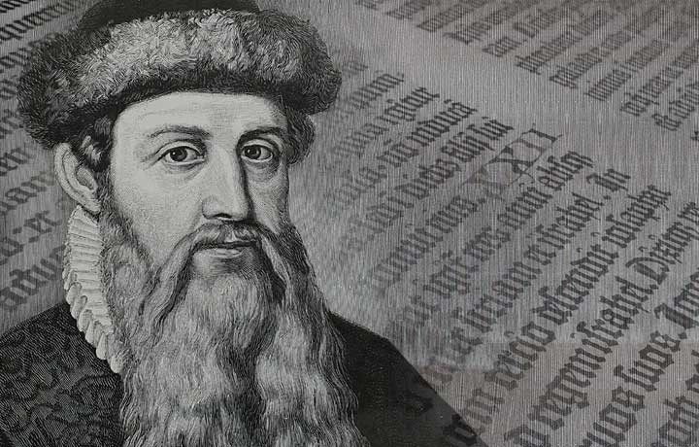
Gutenberg
Gutenberg pattern
Also known as ‘diagonal balance’
Concept comes from Johannes Gutenberg (the inventor of movable type printing)
Applies most strongly to text-heavy content
Image source: http://thecrowncollege.com/tag/johannes-gutenberg/

Slide 6
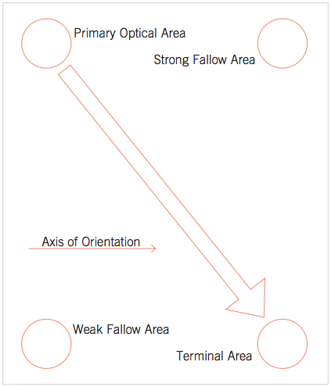
Gutenberg
Our eyes start at the top-left primary area of the page and naturally gravitate towards the bottom-right terminal area.
The axis of orientation is the natural drift from left to right of our eyes.
Image source: http://people.sunyit.edu/~lepres/thesis/principles/119_pdfsam_POD.pdf

Slide 7
Gutenberg
The fallow areas are where the eyes rest less often compared to the primary and terminal areas.
The weak fallow area is where our eyes rest the least.
The terminal area is where our eyes finish.
Image source: http://people.sunyit.edu/~lepres/thesis/principles/119_pdfsam_POD.pdf

Slide 8
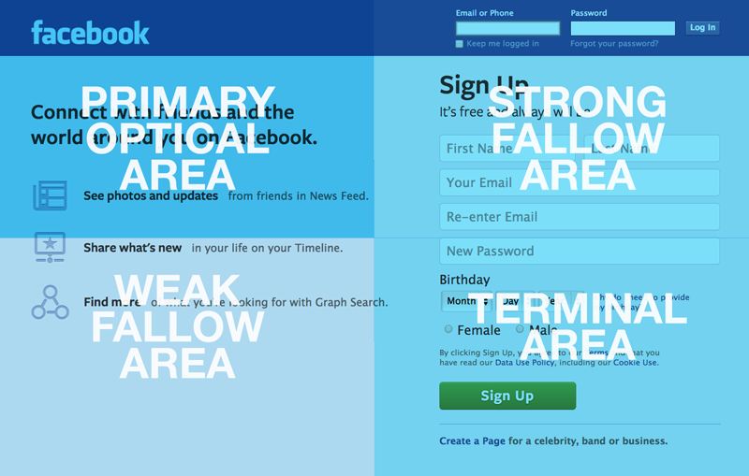
Gutenberg example page
We can use the Gutenberg pattern to assist in our page layout and design.
Image source: https://medium.com/@kurren/designing-experience-design-24b18a670cbc#.fsqm7cccb

Slide 9
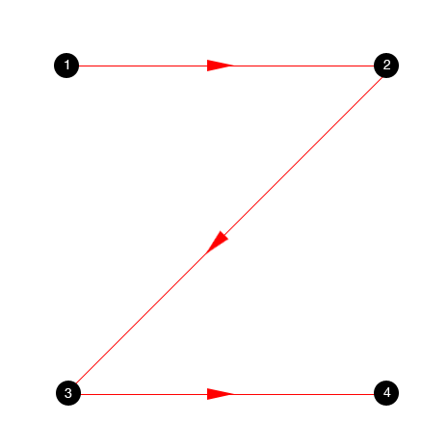
Z pattern
The Z pattern is used for many web pages.
We can place important content at the key areas of the pattern for maximum effect.
Image source: http://vanseodesign.com/web-design/3-design-layouts/

Slide 10
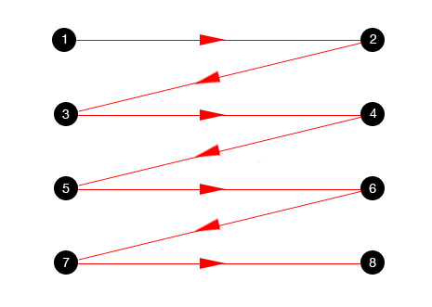
Z pattern
Again, our journey through the page starts top-left and finishes bottom-right.
Along the way, our eyes can perform multiple “Z” shapes or zig-zags.
Can be really effective for pages with less dense content and long-form pages.
Image source: http://vanseodesign.com/web-design/3-design-layouts/

Slide 11
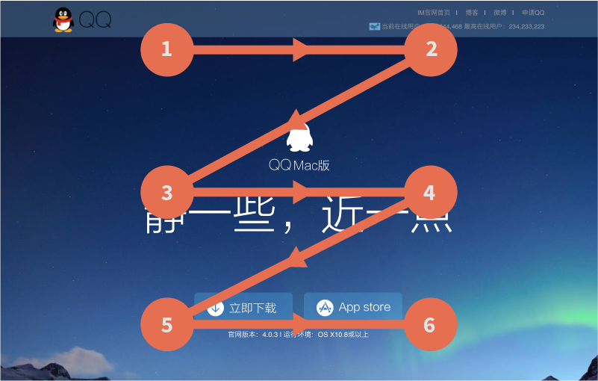
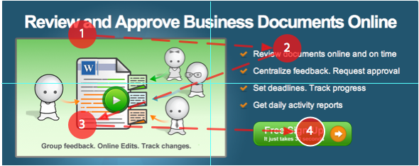
Z pattern example page
Key elements are placed appropriately.
Often, a call to action button is placed in the terminal area.
Image sources: http://daoinsights.com/chinese-user-experience-how-we-read-on-the-web/ (top) and http://uxmovement.com/buttons/why-users-click-right-call-to-actions-more-than-left-ones/ (bottom)

Slide 12
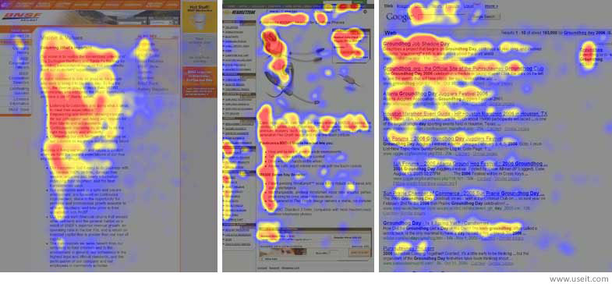
F pattern
Research carried out by Jakob Nielsen tracked readers’ eye movements.
The red areas are where their eyes rested the most.
The pattern created looks roughly like a capital letter “F”
Image source: https://www.nngroup.com/articles/f-shaped-pattern-reading-web-content/

Slide 13
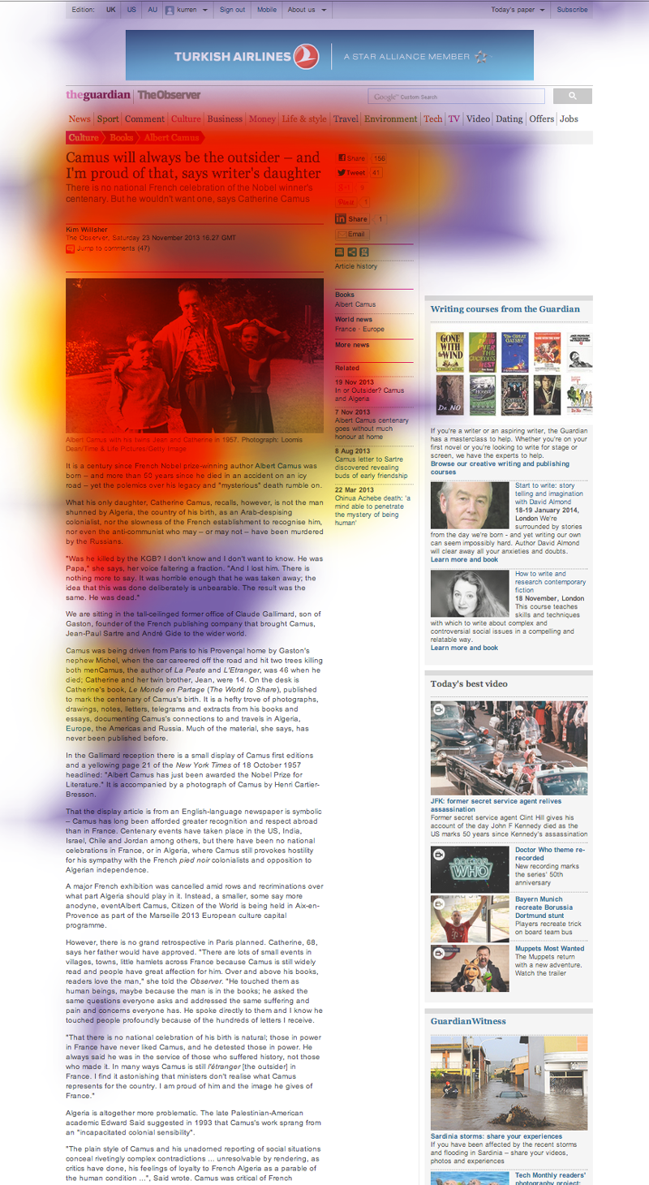
F pattern
The F pattern shows us that when a user is presented with a lot of content, they will very often not read it all.
It also shows us that depending upon the layout, certain content may not be viewed at all.
Image source: https://medium.com/@kurren/designing-experience-design-24b18a670cbc#.fsqm7cccb

Slide 14
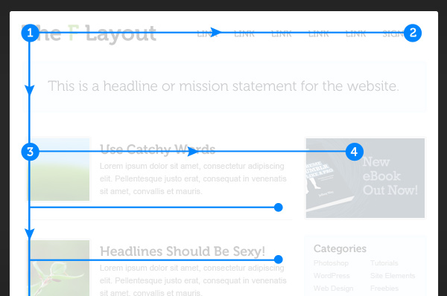
F pattern
The F pattern can be taken advantage of.
It shows us where we could be placing content for best results.
It warns us against overly-wordy content (unless that is the purpose of your site or page and therefore the reason the reader is there).
http://www.creativebloq.com/ux/how-human-eye-reads-website-111413463

Slide 15
Summary
Using one of the three patterns in your layout can have considerable engagement benefits.
Using design, we can leverage the user experience on the page.

Slide 16
Further reading
http://www.creativebloq.com/ux/how-human-eye-reads-website-111413463
http://static.lukew.com/pageheirarchy_lukew_03192008.pdf
http://vanseodesign.com/web-design/3-design-layouts/
http://people.sunyit.edu/~lepres/thesis/principles/119_pdfsam_POD.pdf
https://www.nngroup.com/articles/f-shaped-pattern-reading-web-content/
http://conversionxl.com/10-useful-findings-about-how-people-view-websites/
https://webdesign.tutsplus.com/articles/understanding-the-z-layout-in-web-design--webdesign-28
https://www.smashingmagazine.com/2015/04/design-principles-compositional-flow-and-rhythm/
https://medium.com/@kurren/designing-experience-design-24b18a670cbc#.fsqm7cccb

